Slide 1
Refactoring

Slide 2
Background
Changes are frequently made to existing code to enhance functionality
With time, even if the starting design was good, design deteriorates due to changes
Once design becomes too complex, making changes become much harder and error prone
I.e. quality and productivity of enhancements starts decreasing

Slide 3
Background
Refactoring is a technique to improve the design of existing code
It is done during coding, but the purpose is not to add new features but improve design
Note – refactoring is not to fix bugs; it is applied to code that is working
Has been practiced by programmers, but has taken more formal shape now
It is a an important part of XP and TDD

Slide 4
Basic Concepts
Refactoring is changes made to programs to make them easier to understand and modify but without changing the observable behavior of the programs
  Internal structure of software changes
  External behavior remains the same
Basic objective is to improve design embodied in code; but is not same as improving design during the design process

Slide 5
Basic Concepts…
To improve the design, principles of good design are applicable
Refactoring therefore tries to achieve one or more of the following
  Reduce coupling
  Increase cohesion
  Improve application of open-closed principle
Code is changed to achieve the above, without affecting the functionality

Slide 6
Concepts…
Refactoring is done during coding and is often triggered by some change requests
I.e. if some changes are to be done and it is felt that improving the code structure will make it easier, refactoring may be done
It is best, however, not to mix regular coding with refactoring
I.e. changes for refactoring should be done separately
After refactoring, changes for adding functionality should be undertaken

Slide 7
Concepts…
Main risk of “code improvement” – existing functionality may “break”
To mitigate the risk, two golden rules are
  Refactor in small steps
  Have automated test scripts available to test existing functionality
With small steps, mistakes can be identified easily and rectified
With automated testing, easy to test if external behavior is preserved or not

Slide 8
Concepts…
Refactoring makes design of code continually improving instead of decaying with time
  Extra cost of refactoring is paid for by reduced cost for changes
  Don’t need to have the most general design in the start and can chose simple designs
  Makes initial design task easier and less risky
Refactoring rules are usually for OO

Slide 9
An example
A system to produce graduation report
  A student takes course, writes thesis
  System checks if student has completed graduation requirements and prints the result along with grades
  A student may be undergraduate (UG) or post graduate (PG)
  Graduating requirements for the two are diff in no of courses and thesis

Slide 10
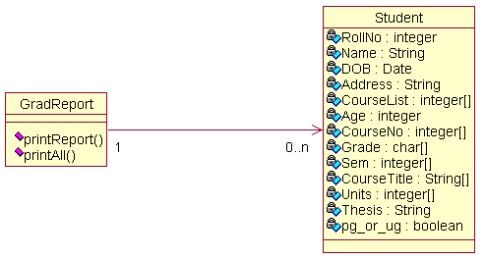
Initial Class Refactoring

Slide 11
Design Issues
All logic for printing is in one method – increases coupling with others, and has less cohesion
Class cohesion is poor – one class does everything
Student class contains too many concepts
To improve this design, will do a series of refactorings

Slide 12
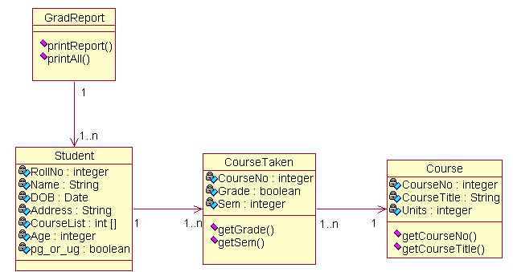
First Refactoring

Slide 13
First Refactoring…
Cohesion is improved by creating a new class Course which contains info about the course
A class CourseTaken which contains info related to courses a student takes
Responsibilities are suitably distributed
Arrays have been converted into objects
Redundancy about course info has been eliminated
The external behavior is the same and an older test script can be used

Slide 14
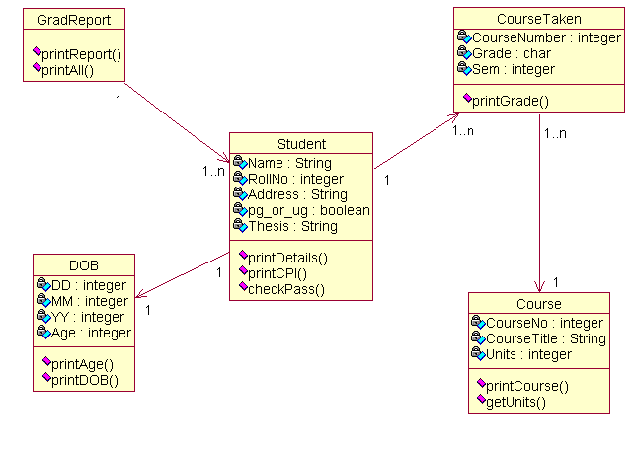
Second Refactoring

Slide 15
Second Refactoring…
Have added a DOB class which improves cohesion and flexibility as DOB is a general class which can be reused
Responsibility of printing is now distributed to where the information resides (reduces coupling)

Slide 16
Final Refactoring
Use inheritance as open-closed principle is still being violated (if a new category of student is added, code has to change)
We add a general class Student and make UG and PG as subclasses
The external behavior is still the same and original test scripts can be used

Slide 17
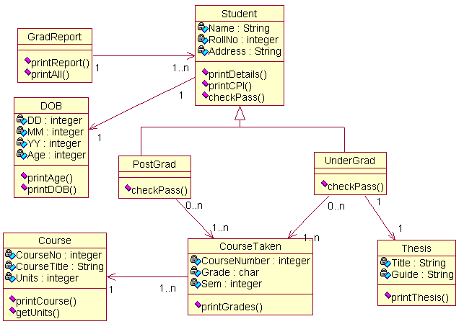
Final Class Diagram

Slide 18
Bad Smells
When can we say refactoring is needed?
Signs for refactoring are “bad smells”
These are easy to spot signs in code which can indicate need for refactoring
These are not guarantees, only bad smells
Case-by-case analysis is necessary

Slide 19
Bad Smells…
Duplicate code: Common; same functionality in different places; harder to change the logic
Long method: may be trying to do too many things
Long class: encapsulating multiple concepts? May not be cohesive
Long parameter list: complex interfaces are undesirable; simplify if possible

Slide 20
Bad Smells…
Switch statements: Not using inheritance property – if so, similar switch will show up in diff places; makes it hard to change
Speculative generality: subclass is the same as parent; no reason to have this hierarchy
Too much communication between objects: classes and methods may not be cohesive
Message chaining: one method calls another which calls another; unnecessary coupling

Slide 21
Common Refactorings
There are a large no of possibilities to improve design of programs
Catalogs exist; new refactorings get added
For improving design, the focus is either methods, classes, or the class hierarchies
Through these, coupling or cohesion is improved
We will discuss some refactorings under these categories

Slide 22
Improving Methods
Extract Method
  Done if a method is too long
  Split into short methods whose signatures indicate what the methods do
  Code pieces extracted out as new methods
  Vars referred in this piece become parms
  Vars declared in this but used elsewhere will have to be defined in original method

Slide 23
Improving Methods…
If a method returns value but also changes state – split it into two
Add/Remove parameter
  To simplify interfaces where possible
  Should be done only when extra parms are there or adding parms help

Slide 24
Improving Classes
Move method
  Shift a method from one class to another
  Done when the method interacts too much with objects of other class
  It may be better initially to leave a delegating method in the initial class which invokes this
Move field
  If an attribute is used more by another class, move it to that class
  Enchances cohesion and reduces coupling

Slide 25
Improving Classes…
Extract class
  If a class is encompassing multiple concepts, split with each class of one concept
  Cohesion improves
Replace data values with objects
  Sometimes collection of attributes become a logical entity
  Separate them as a separate class and define objects to access them

Slide 26
Improving Hierarchies
Replace conditional with polymorphism
  If behavior depends on some type-code, OO power is not being exploited
  Replace such case stmts by having a class hierarchy
Pull up Field/Method
  Common elements should belong to super
  If functionality or attr are duplicated in subclasses, they can be pulled up in super

Slide 27
Summary
Design embedded in code deteriorates with time as changes are made
Refactoring improves the design in code without adding new functionality
Focus is on improving cohesion or reduce coupling or using the open-closed principle
There are bad smells to identify when refactoring is needed
Many refactorings have been proposed; new ones keep getting added

